Slide 1

Global Poverty Project :
Poverty & Health
By Avramidis Theofilos and Korolis Alexandros

Slide 2
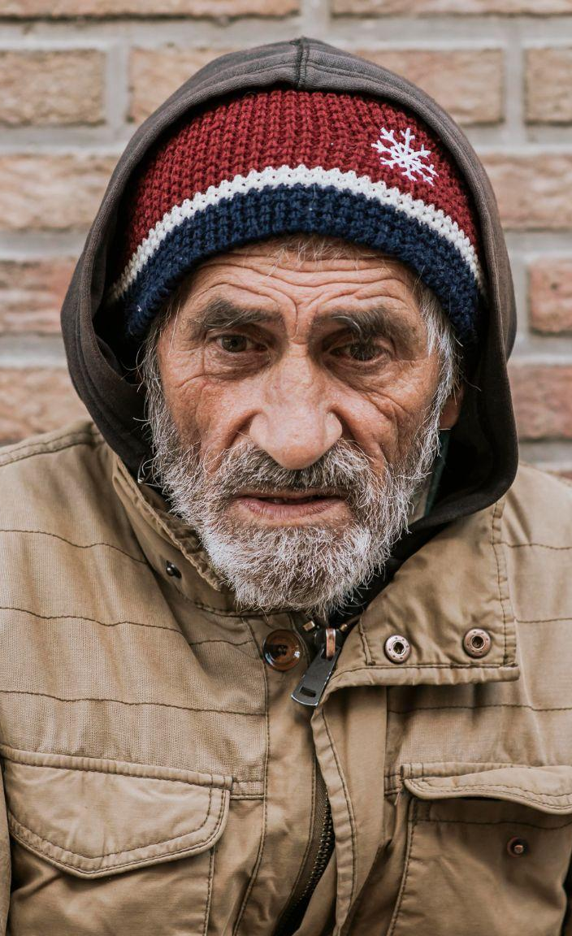
Introduction
The purpose of this project is to categorize countries all around the world based on social-economic and health features in order to provide people from poor countries humanitarian aid.

Slide 3
01
EDA
Table of contents
02
Modelling
03
Labelling
04
Conclusion
Exploratory data analysis
Problem modeling and categorization
Analyze and labeling different categories
Inferences and final review

Slide 4
01
EDA
Exploratory Data Analysis , introduction to the dataset

Slide 5
EDA
Observations from 167 countries around the world .
Based on 10 features (related to socio-economic and health factors) .
No missing or duplicate values .
Existence of extreme values in the dataset .

Slide 6
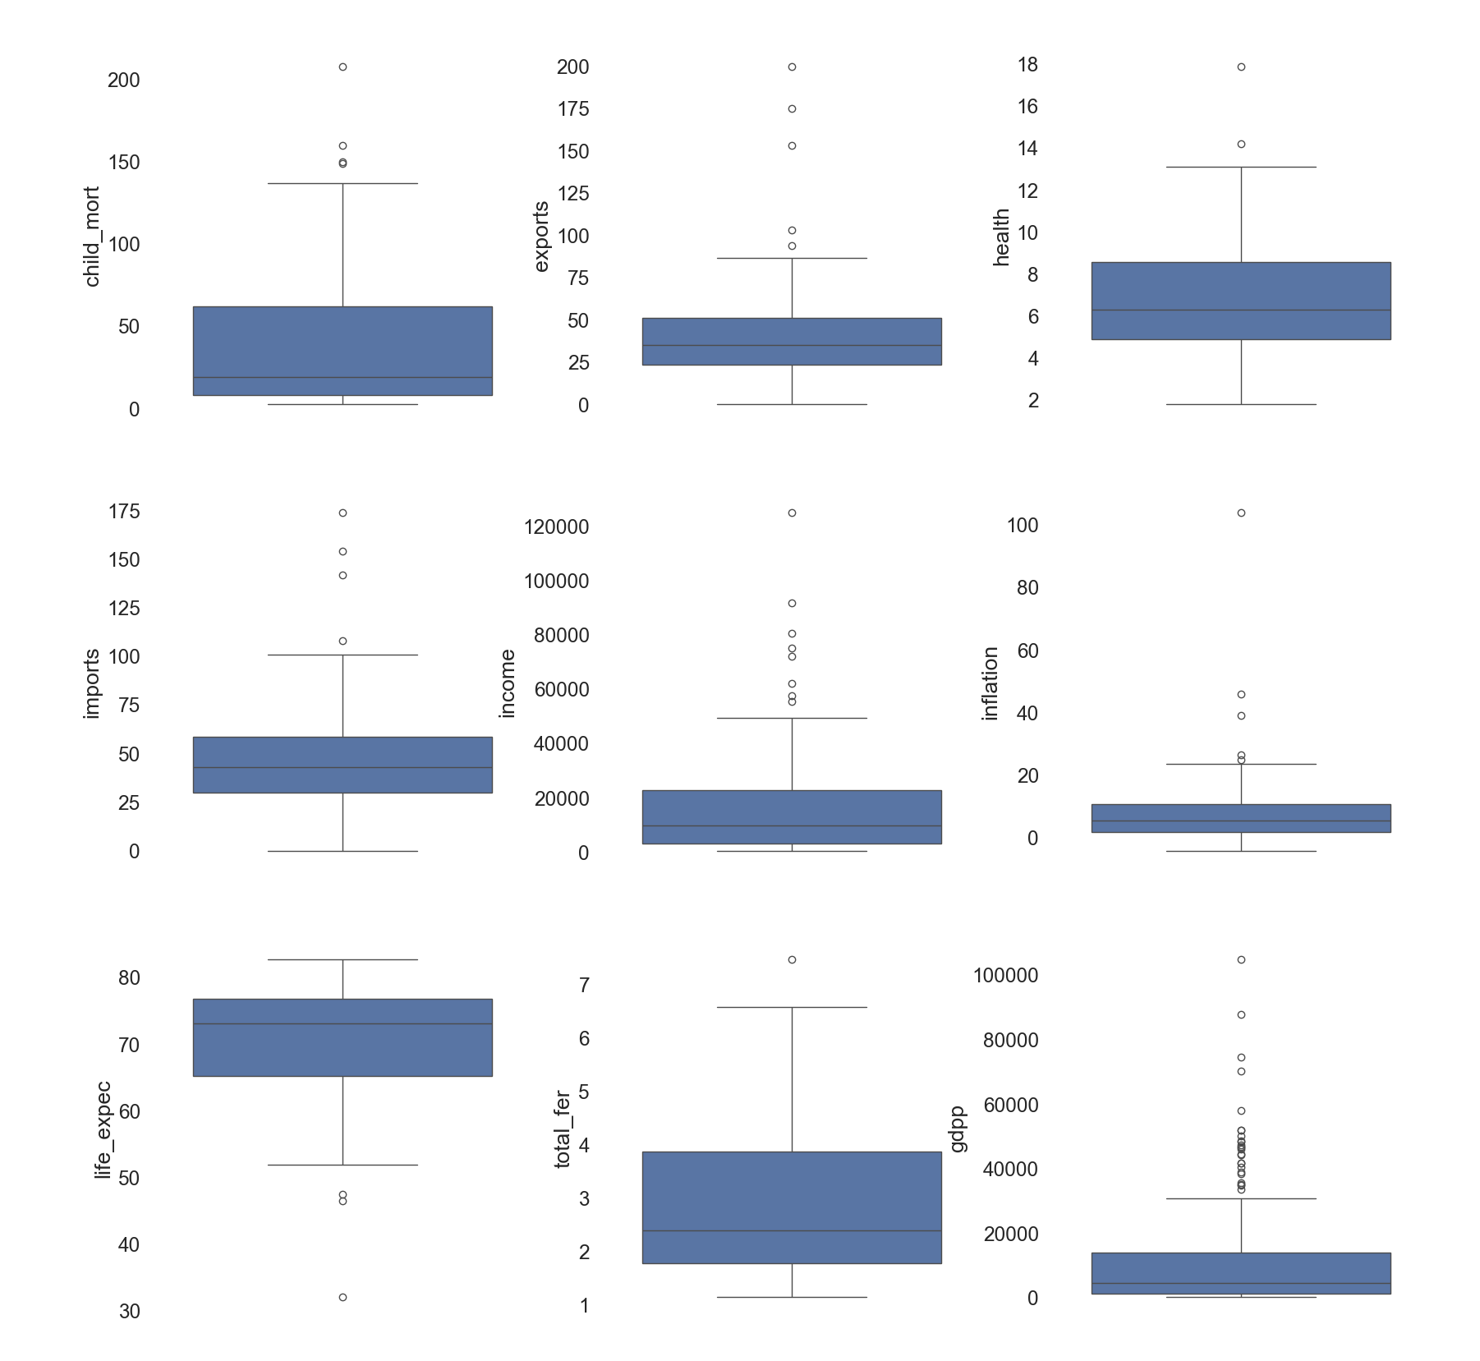
EDA

Slide 7
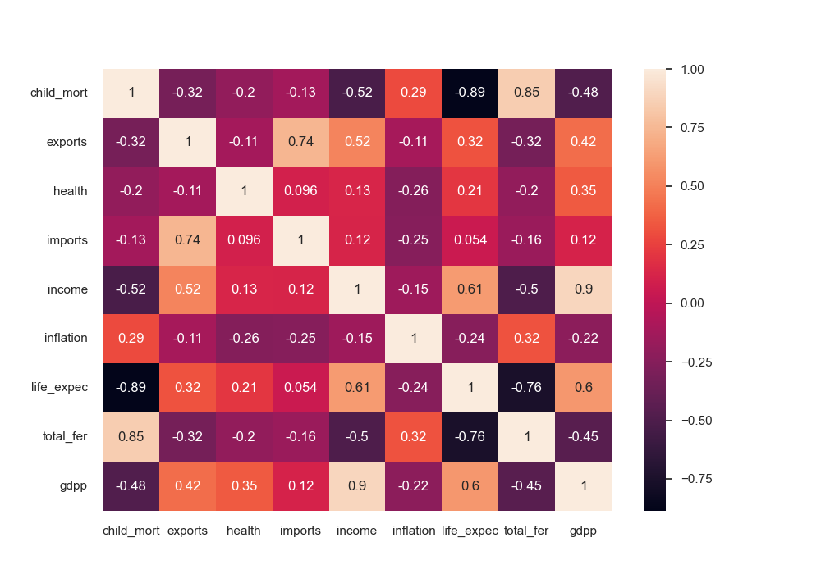
EDA
Life expectancy ~ gdpp
Income ~ child mortality
Income ~ life expectancy
Income ~ health

Slide 8
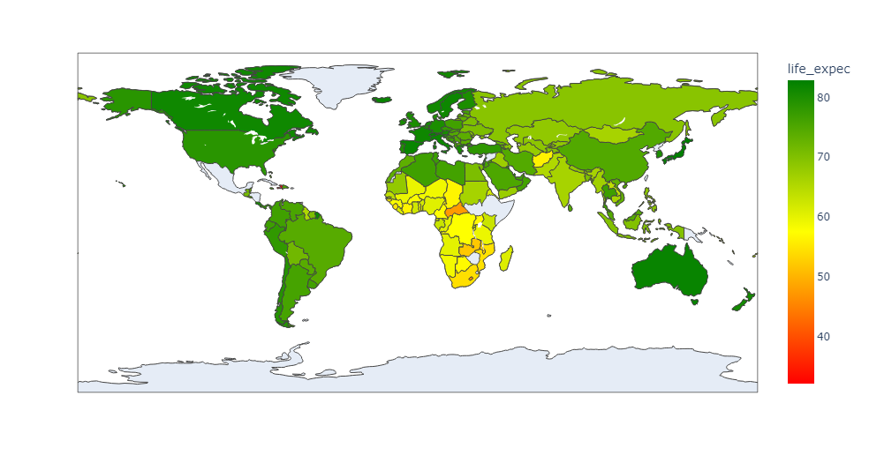
EDA
Lesotho has the lowest average life expectancy
with 46.5 years
Japan has the highest average life expectancy with 82 years

Slide 9
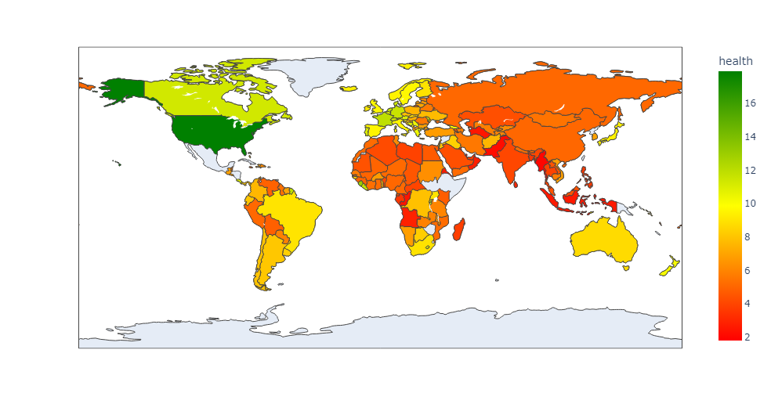
EDA
Qatar has the lowest total health spending per capita. (1.81%)
United States has the highest total health spending per capita. (17.9%)

Slide 10
02
Modeling
Problem modeling and categorization

Slide 11
Modeling
Scale the data, in order to compare and decide the category.
Applied k-means (optimum distance between each data point and a centroid).
Evaluation based on elbow visualization and silhouette.

Slide 12
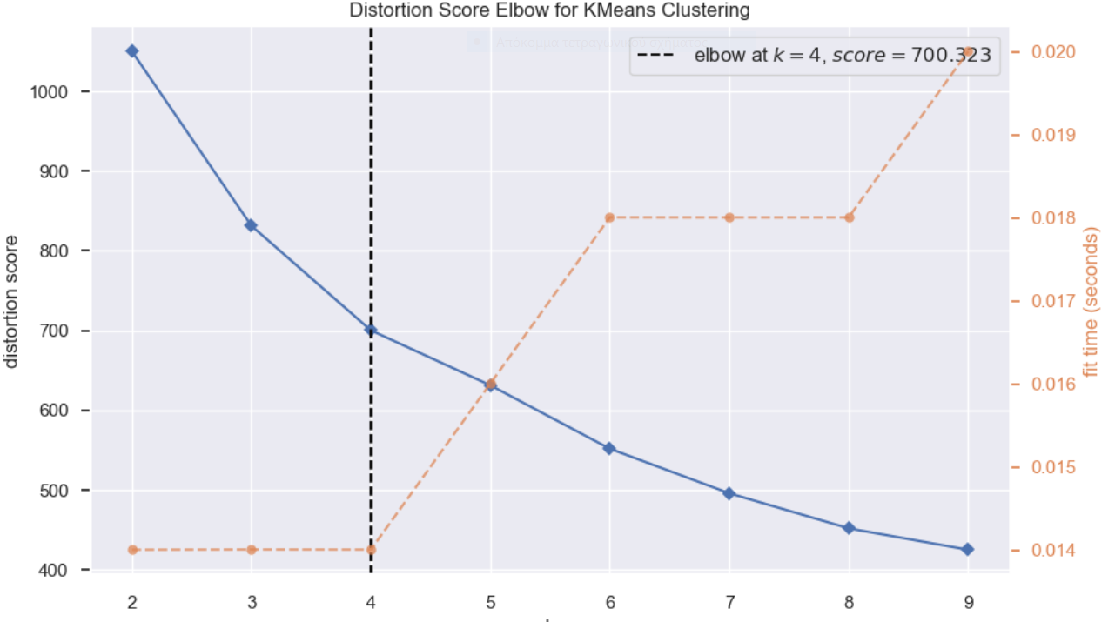
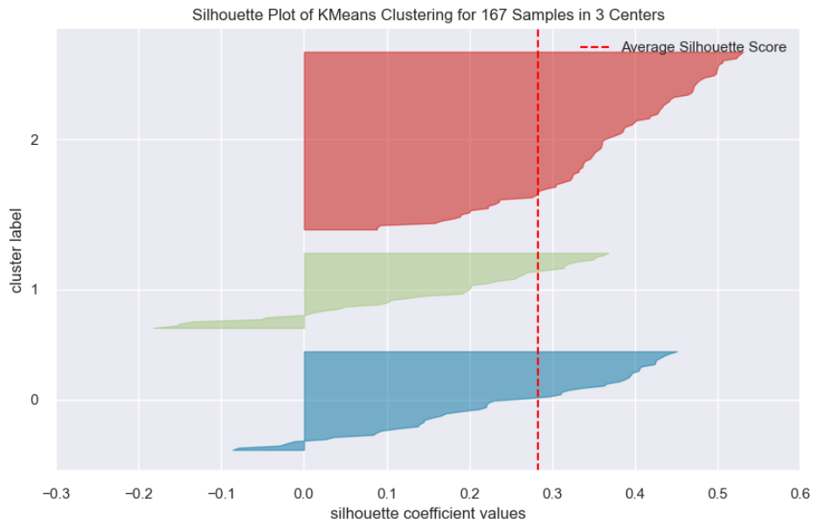
Modeling
Distortion : the distance between the data points in the same category.
(How dense a category is.)
How far the categories are. (The further the better)

Slide 13
03
Labelling
Analyze and labeling different categories

Slide 14
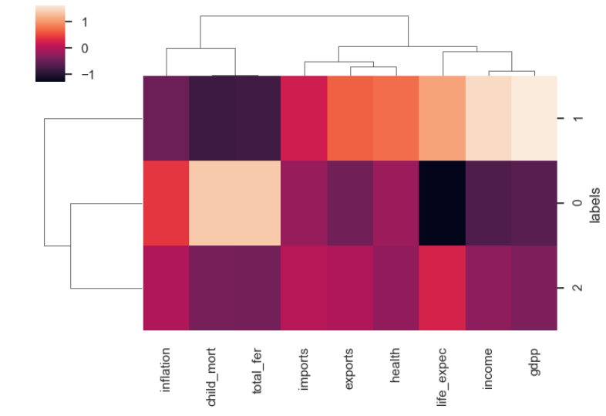
Labelling

Slide 15
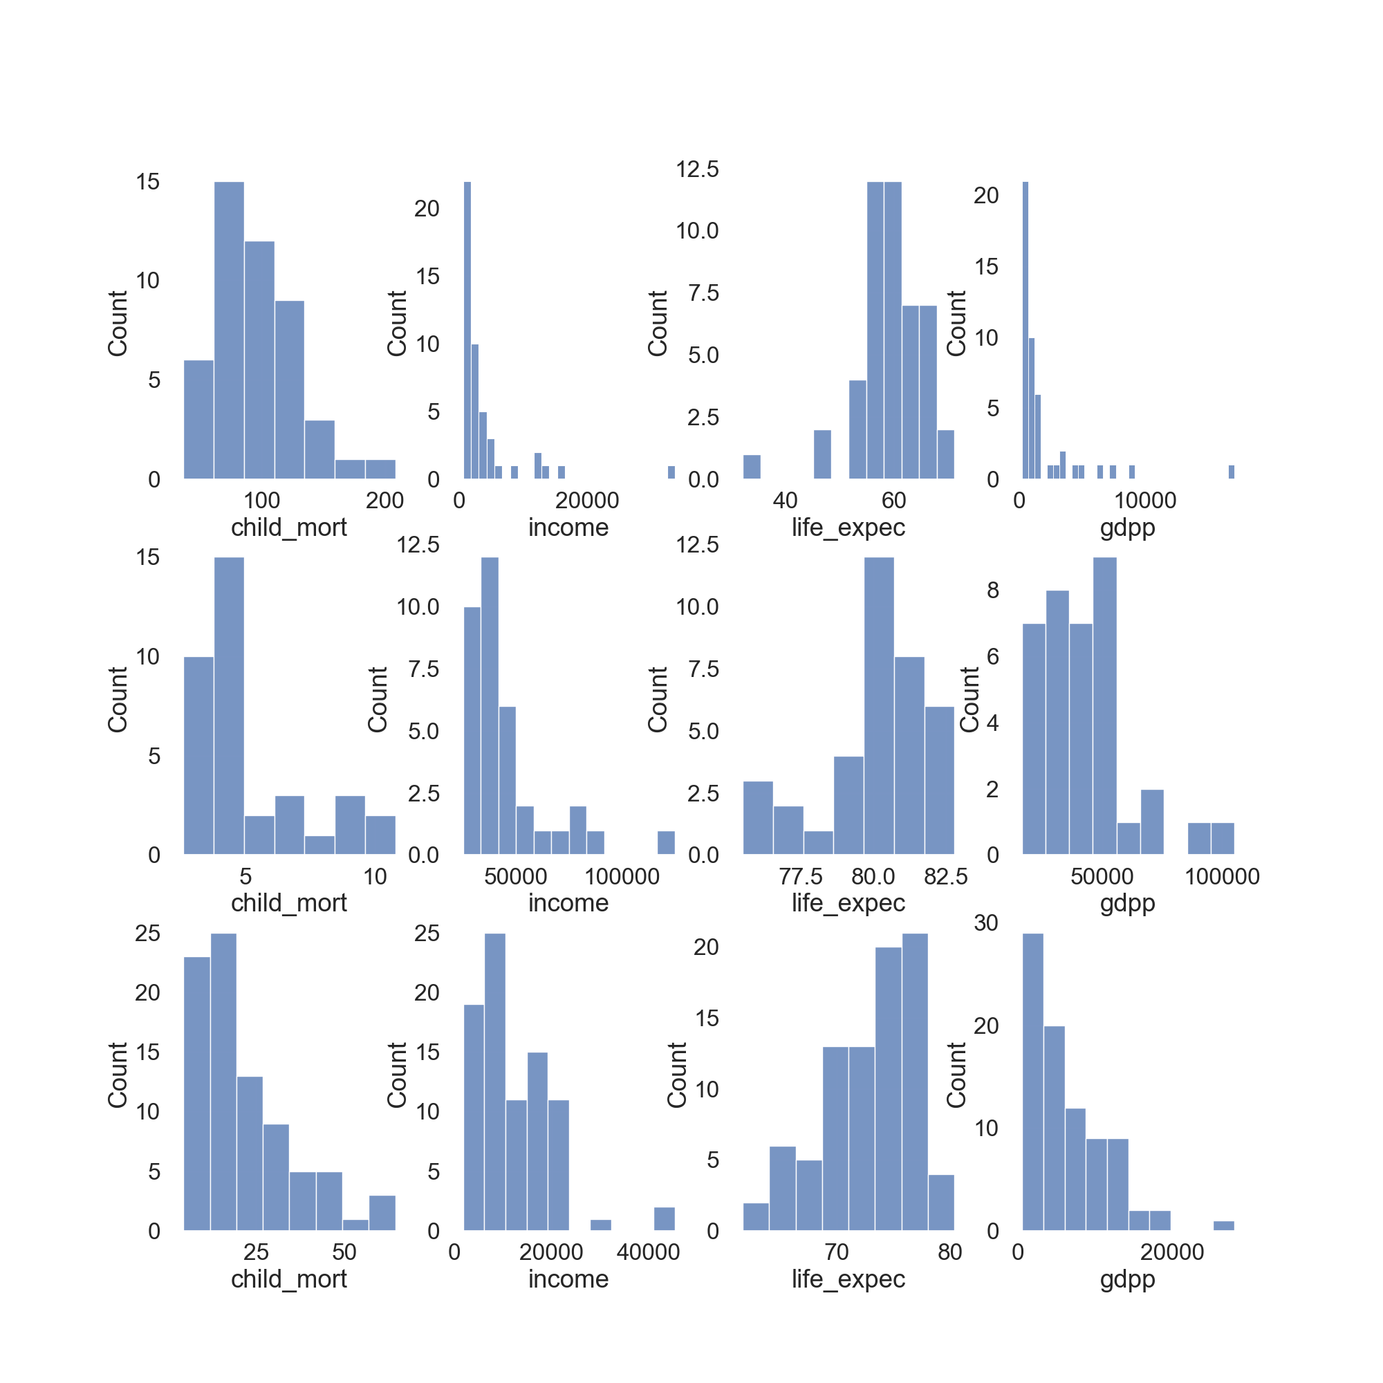
Labelling
Cluster 0 :
Cluster 1:
Cluster 2:

Slide 16
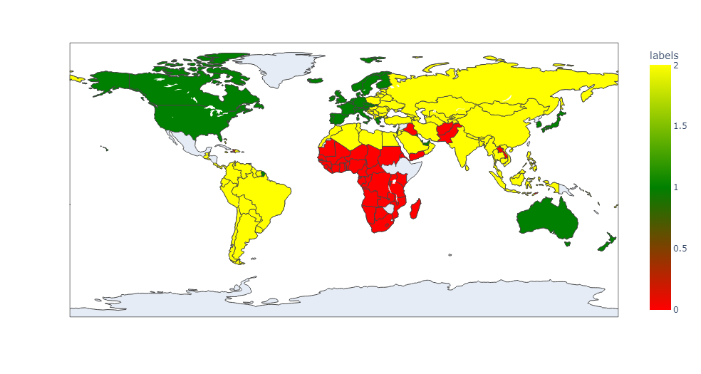
Labelling
Green : Rich countries
Yellow:Middle class countries
Red: Poor countries

Slide 17
04
Conclusion
Inferences and final review

Slide 18
Conclusion
We can categorize countries based on the features of our dataset.
Characteristics of Developed Countries are : higher GDPP, Income and Life expectancy .
Characteristics of Least Developed Countries are : higher Child Mortality, higher total Fertility .
Developing Countries fall in between the Rich and Poor Countries .

Slide 19
Thank You !!!

